Slide 1
Understanding Digital

Slide 2
Understanding Digital
How the digital camera works
CCD Sensor
Processor
Output –Storage devices
-File types
Jpeg-Joint Photographic Experts Group
TIFF – Tag Information File Format
RAW

Slide 3
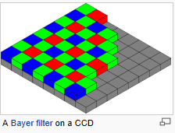
Understanding Digital

Slide 4
CCD to Memory

Slide 5
From Camera to Printer
Digital camera features
Auto
Aperture priority
Shutter priority
Manual
Programme
Preset functions

