Slide 1
Extreme close-up photography
A1 Camera Club
Simon Williams February 2021

Slide 2
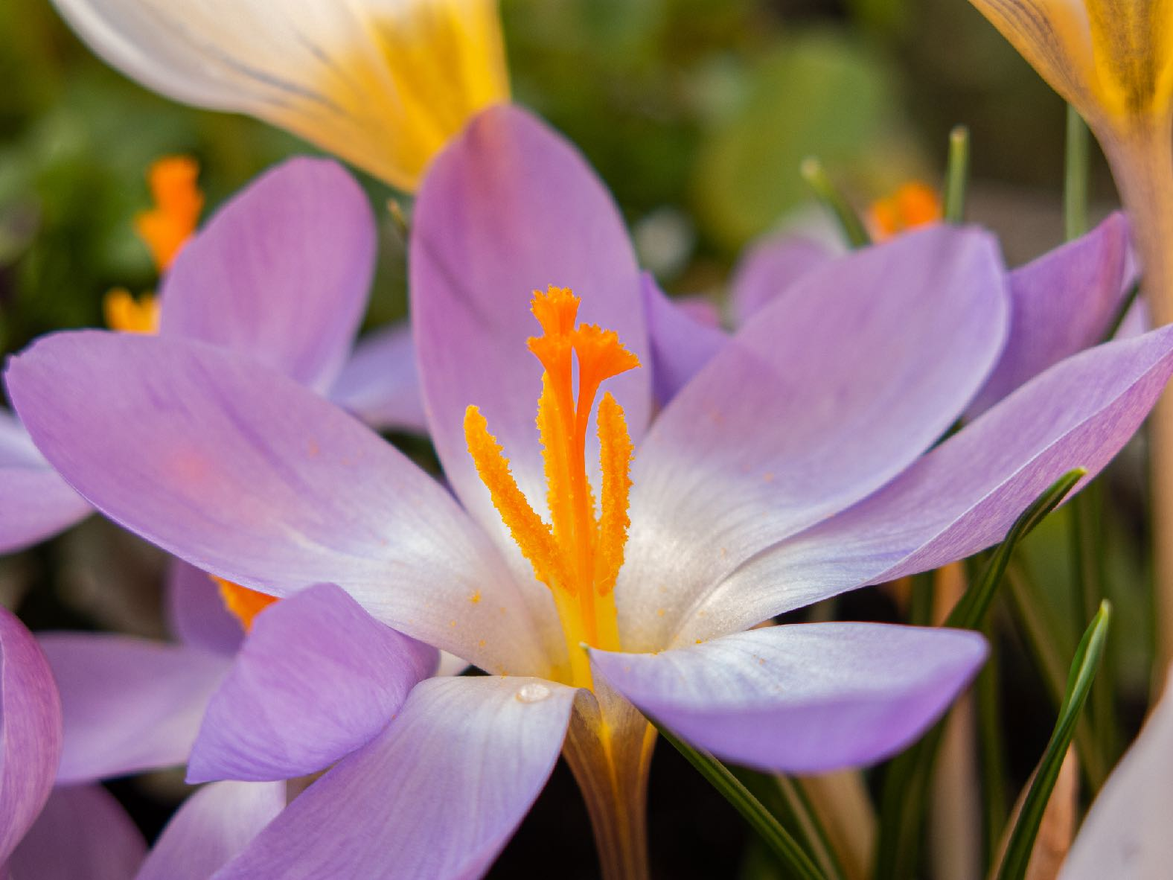
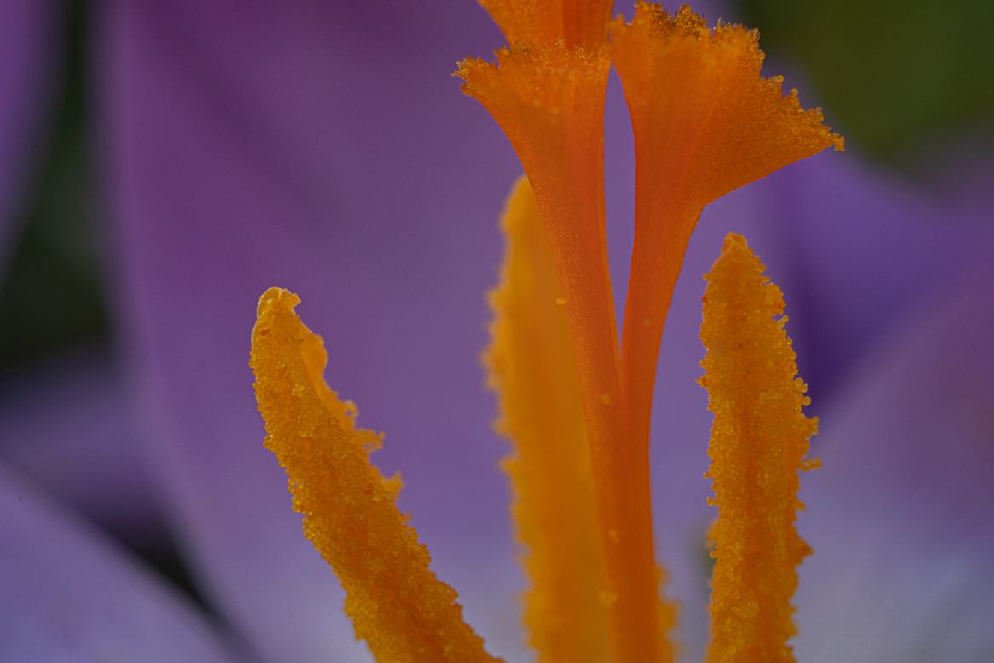
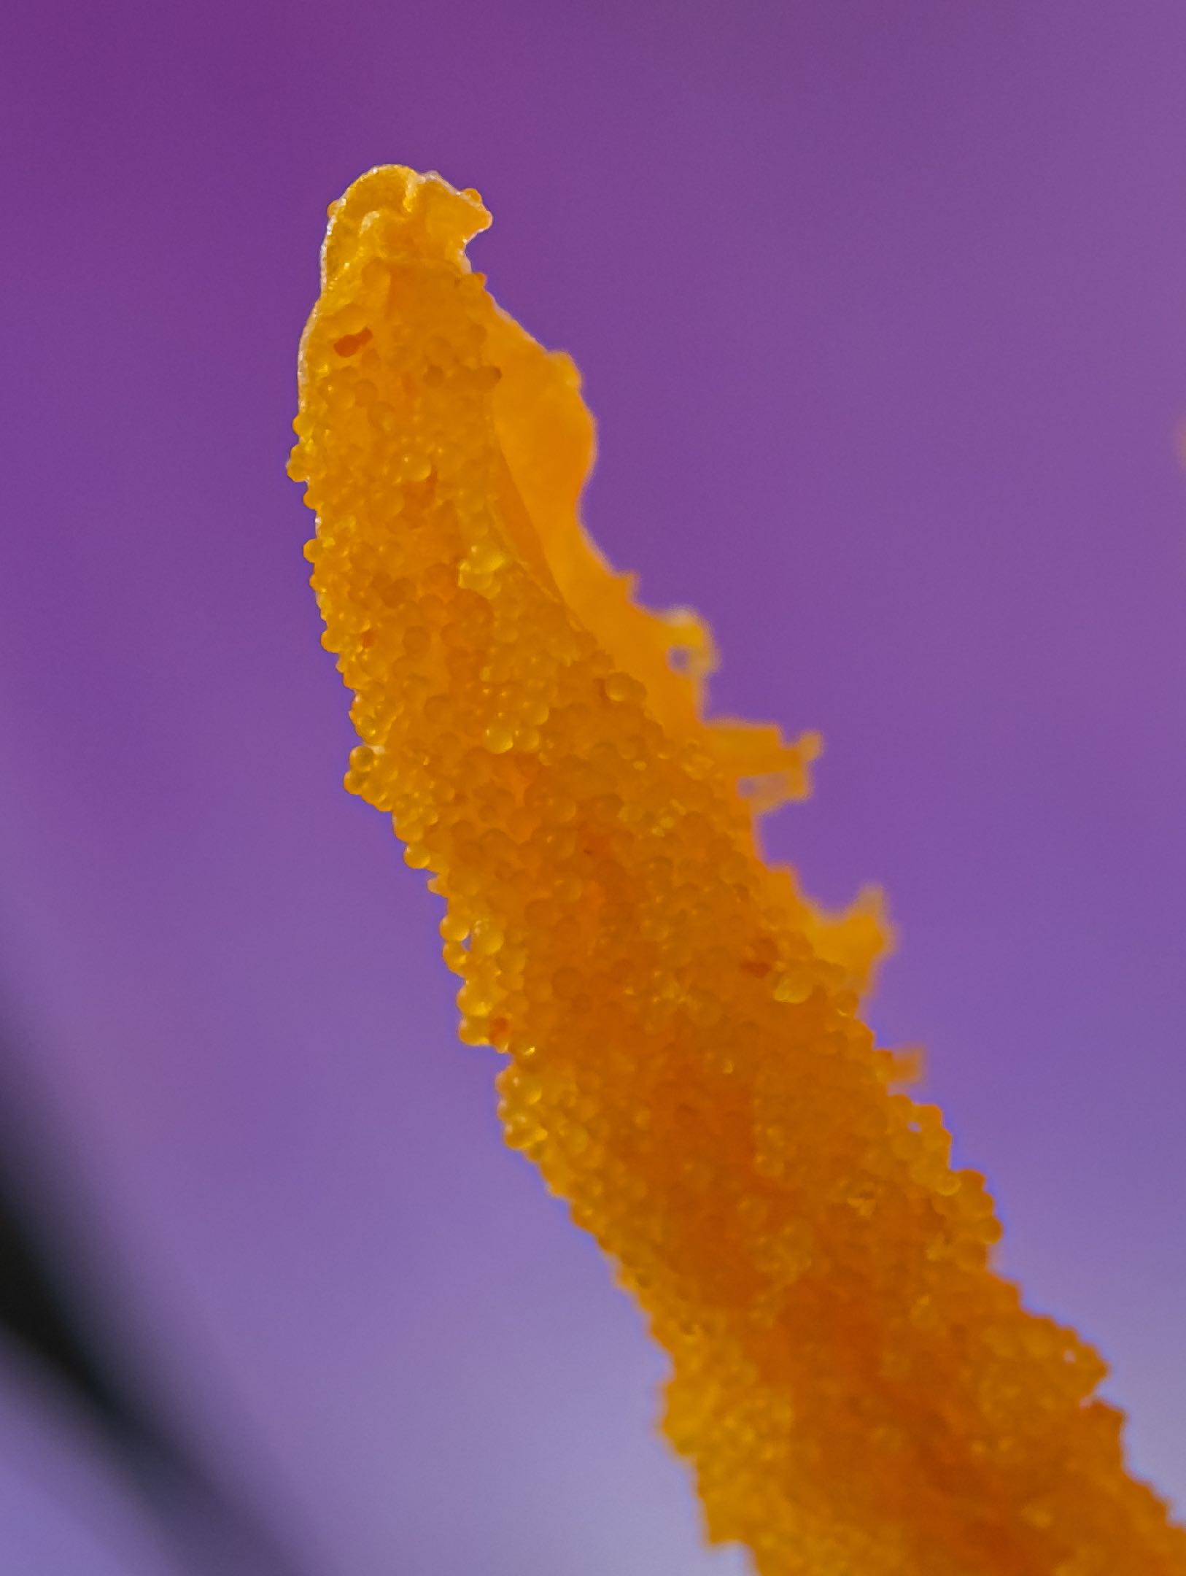
Close up Macro Extreme close-up
What’s the difference?

Slide 3
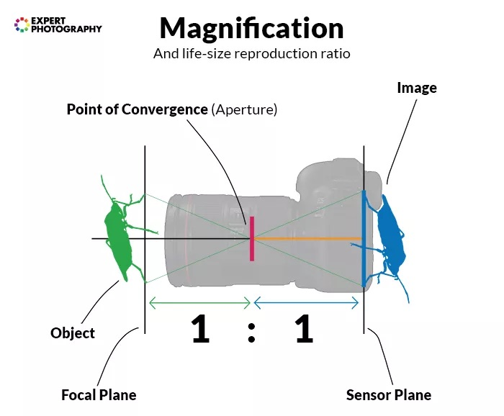
Macro
The image on the sensor is the same size or larger than the object.
Note the object and image distances to the aperture are the same in 1:1.
To magnify, the object will be closer to the aperture than the sensor is to the aperture.

Slide 4
Sensor sizes
Smaller sensors will have less of the object in view for a given magnification
https://www.olympus-lifescience.com/en/microscope-resource/primer/java/lens/bi-convex/

Slide 5
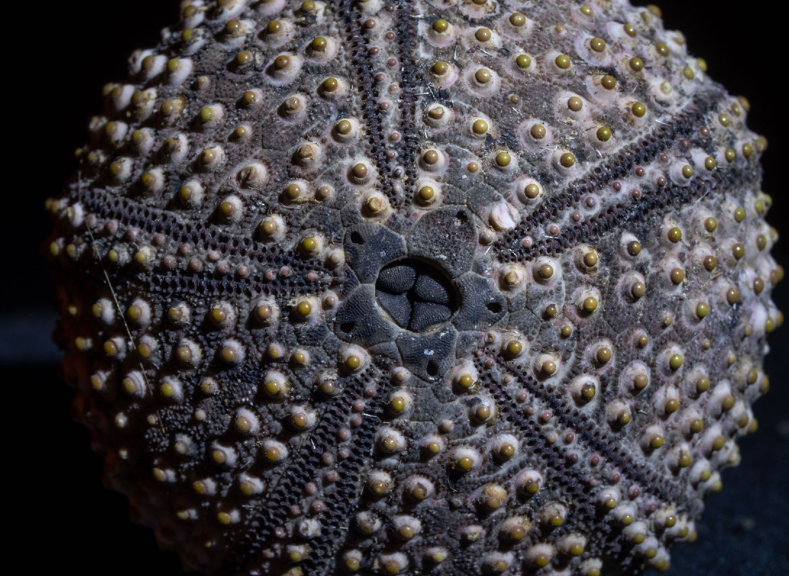
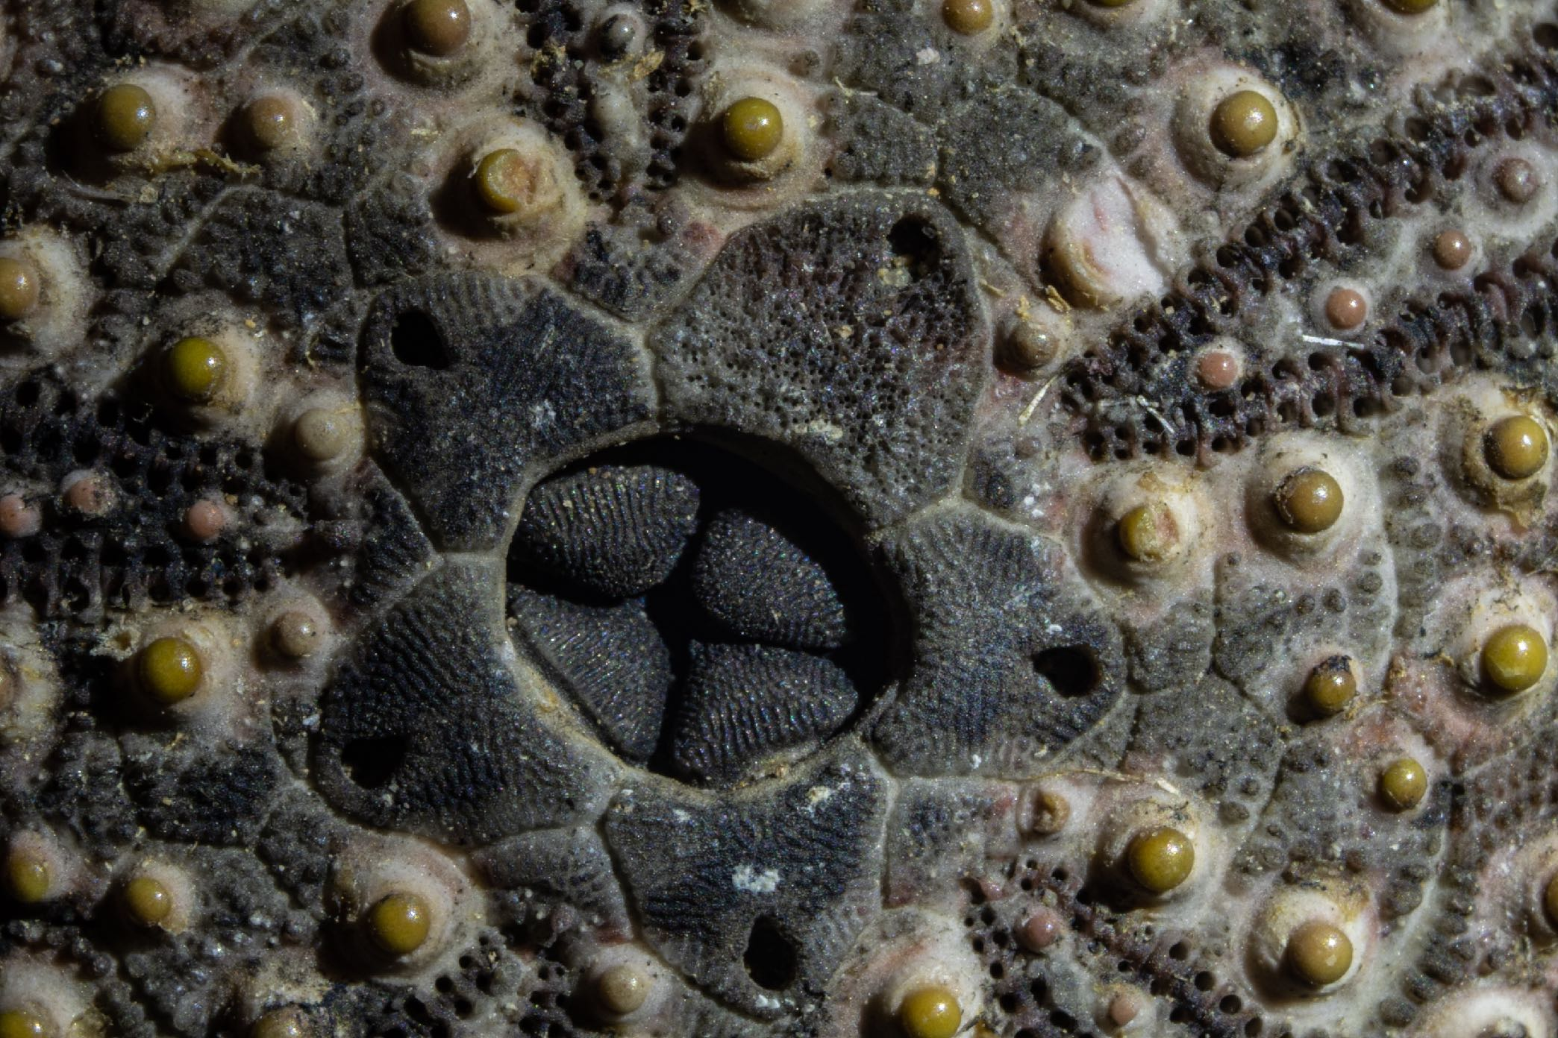
Close up Macro Extreme close-up
What’s the difference?

Slide 6
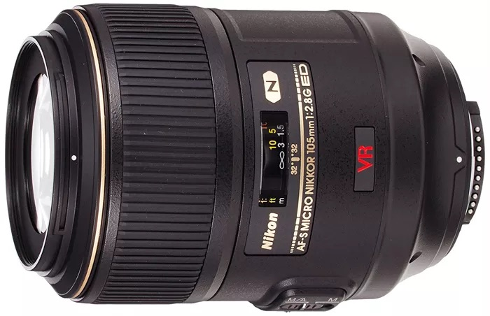
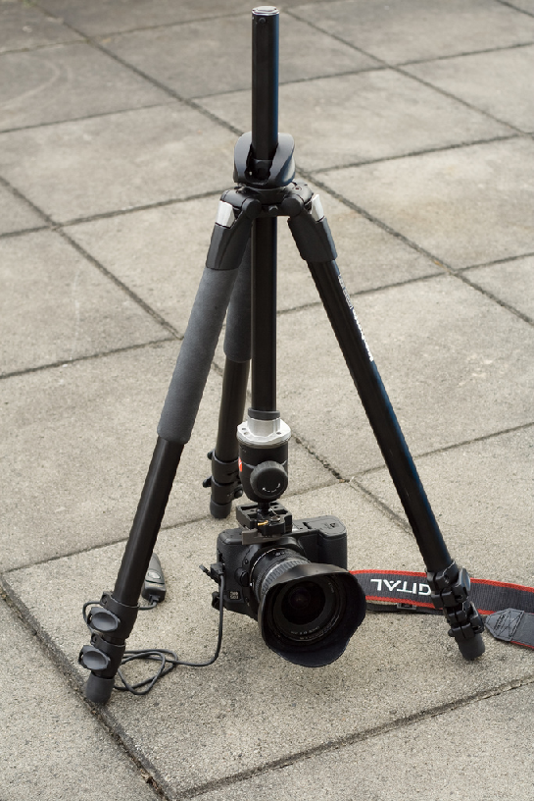
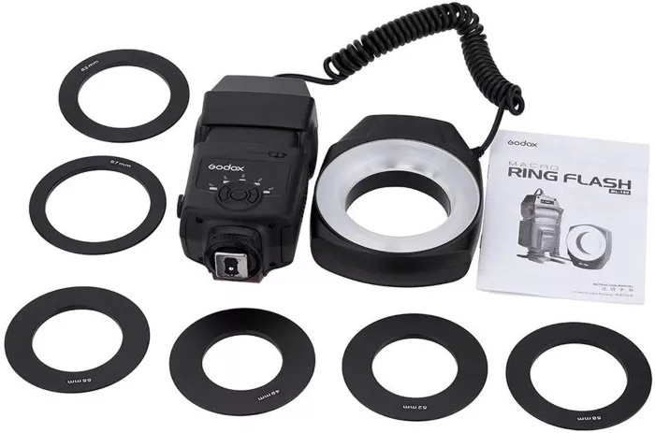
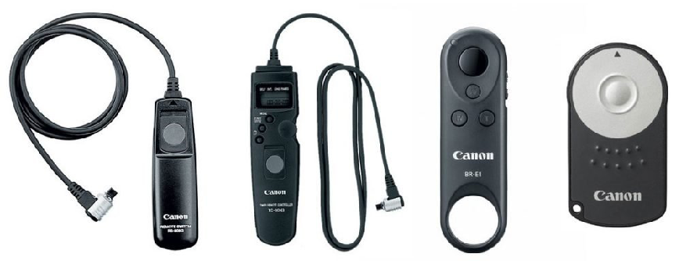
What equipment do you need?
Suitable lens
- Zoom/telephoto
- Specialised Macro lens (Typically 80-100mm)
- extension tubes (From £18)
- reversing lens adapter (From £12)
-NOTE: electronic focussing lenses are not good for this, but secondhand manual lenses can be bought quite cheaply - at the moment
Tripod
use “upside down”
Lighting
- Continuous (Single sources or ring)
- Flash
- Natural light
-light tent/cube for diffused light
Cable Release
- or time delay on camera
Clamps and supports - pegs, pins plasticine

Slide 7
What camera do I need?

Slide 8
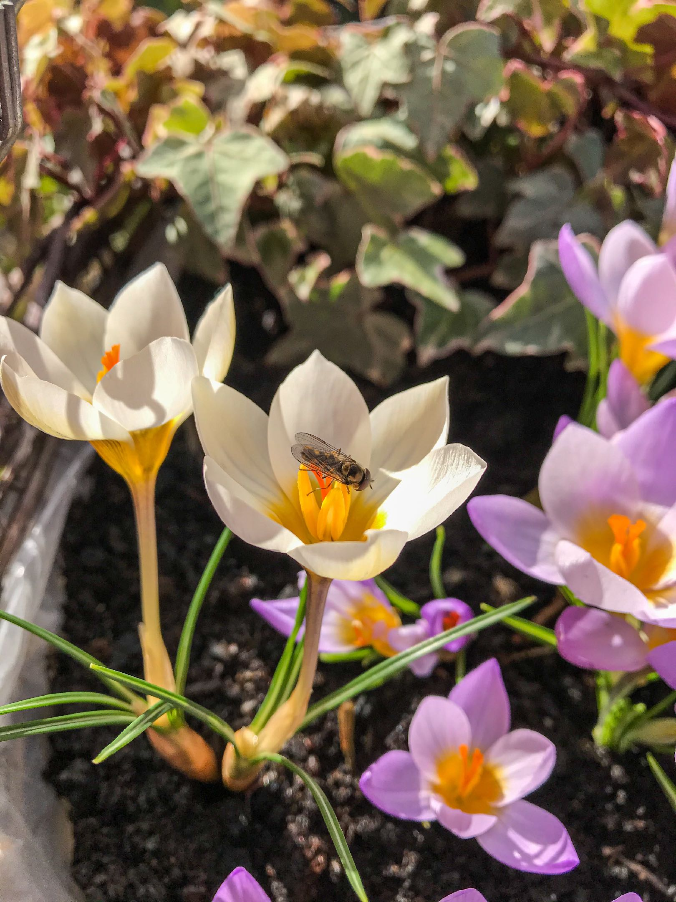
Howard’s-Phone
I-Phone

Slide 9
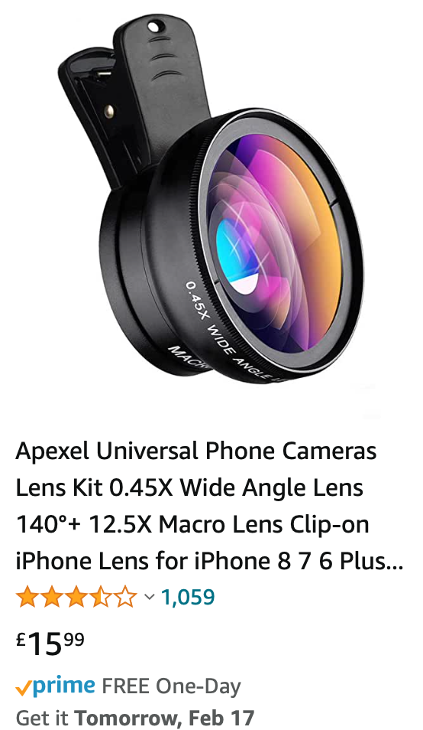
Phone attachment

Slide 10
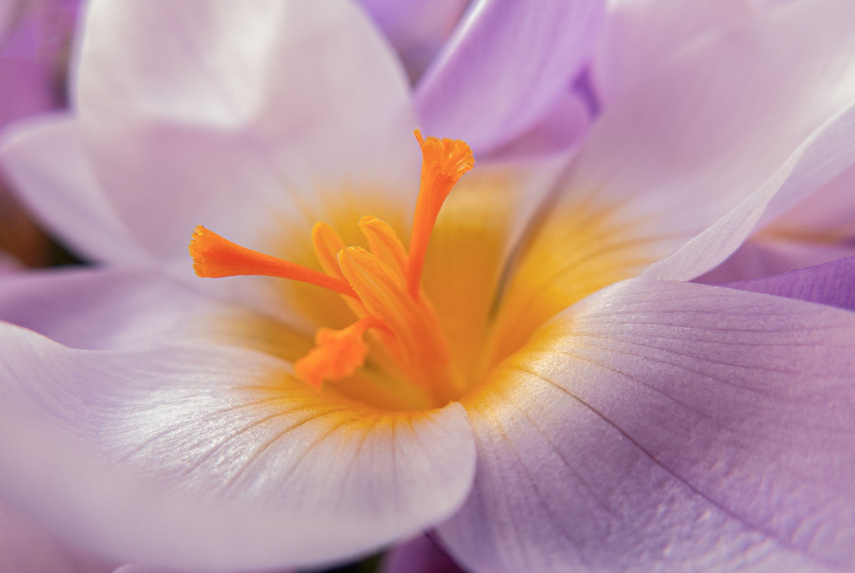
Compact Canon in macro mode

Slide 11
APSC Fuji with extension tube

Slide 12
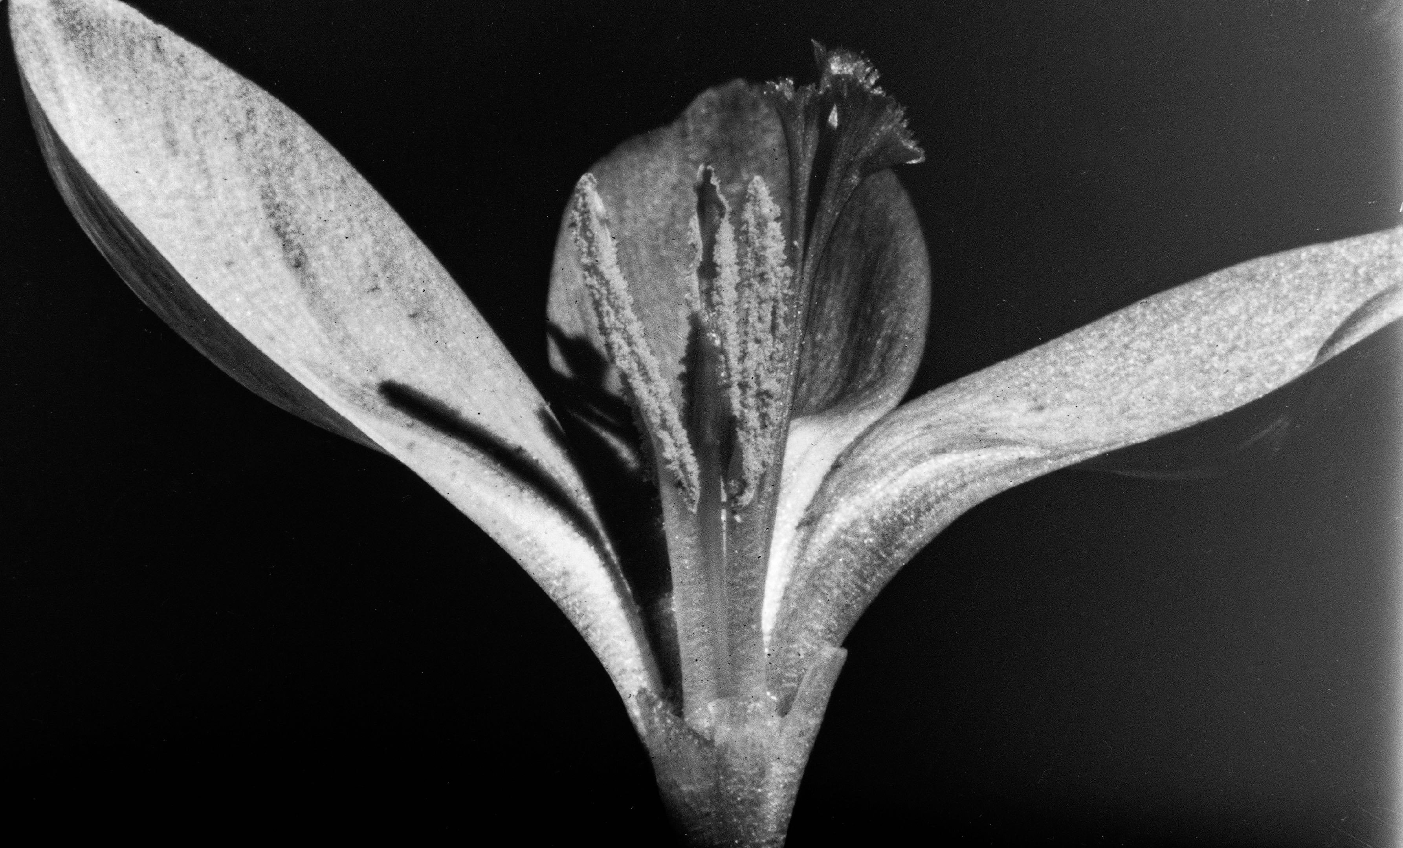
1900s Plate camera. Image 4 inches wide

Slide 13
Subjects?
Whatever you find fascinating!
Insects
Plants
Found things shells, stones
Everyday objects
Feathers
Water droplets
Ice-frost
Water
Bubbles

Slide 14
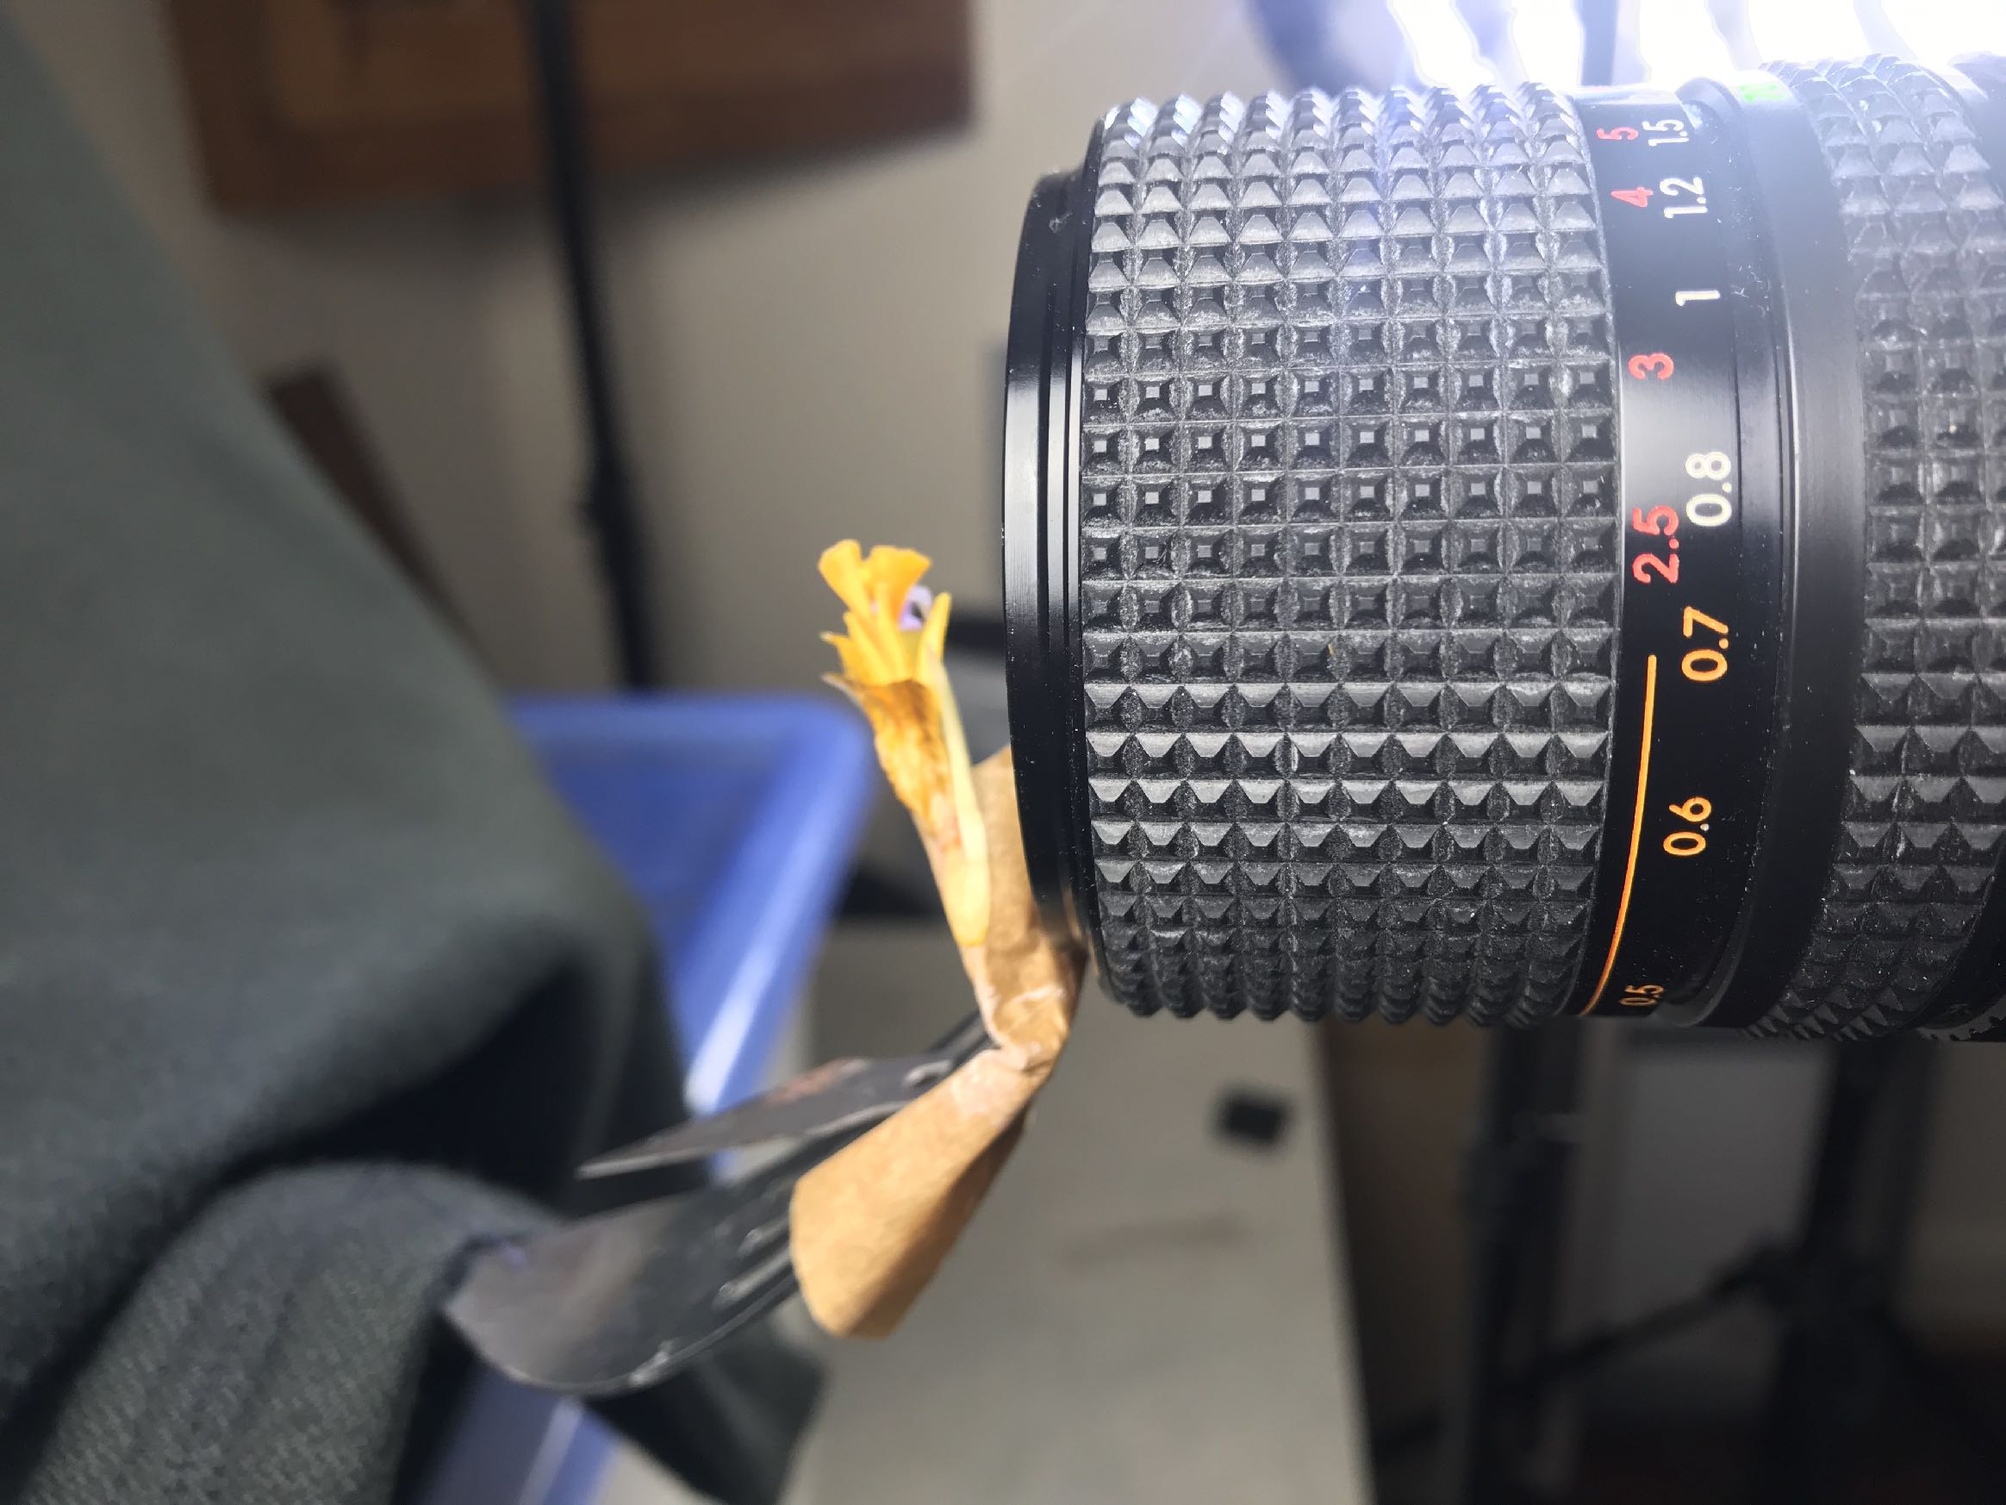
Challenges?
Depth of field
“the typical aperture number for macro photography is between f/5.6 and f/11.” I say use what works! Small apertures (larger F numbers) help keep more of your subject sharp and in focus.
Focussing
- live view helps (focus peaking)
- focus stacking (in camera or post)
Lighting
- especially when the lens is close to the subject
Background
- reducing distractions

Slide 15
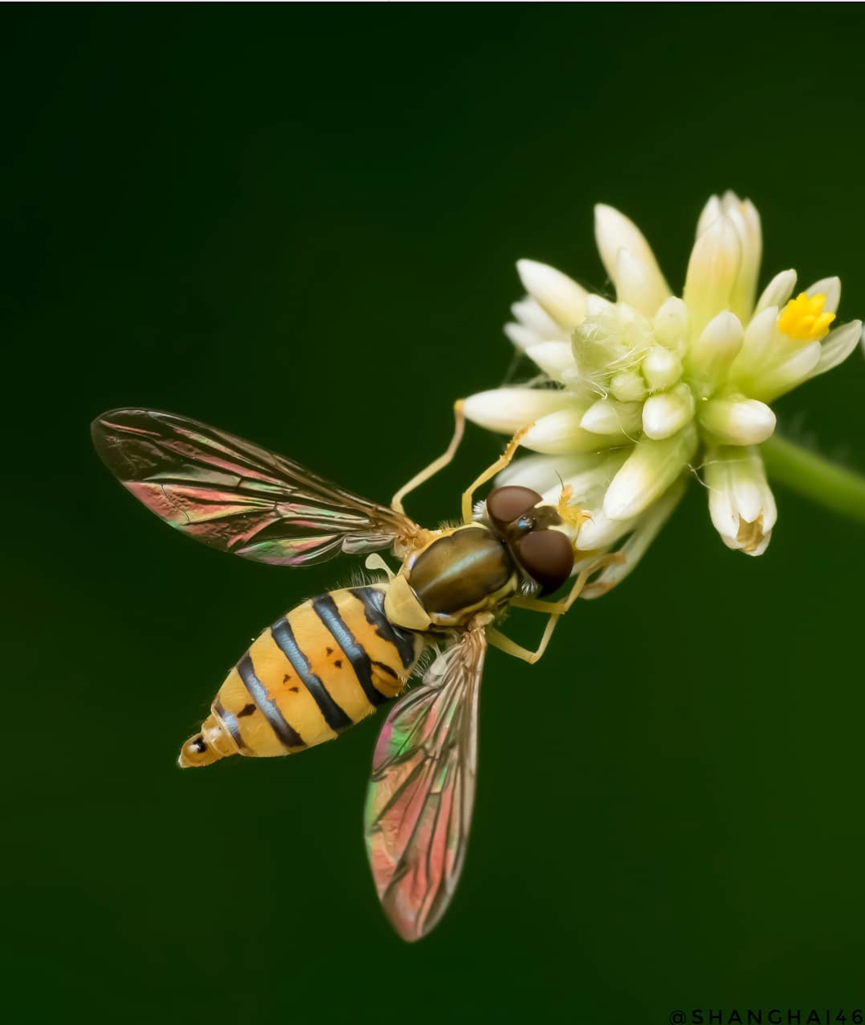
Challenges?
Composition
- as important as in landscapes/still life etc
- creating a pleasing and/or dramatic image: we cannot rely on the fact this point of view is unusual to make a great image.
https://www.theatlantic.com/photo/2020/11/winners-close-up-photographer-year/617070/

Slide 16
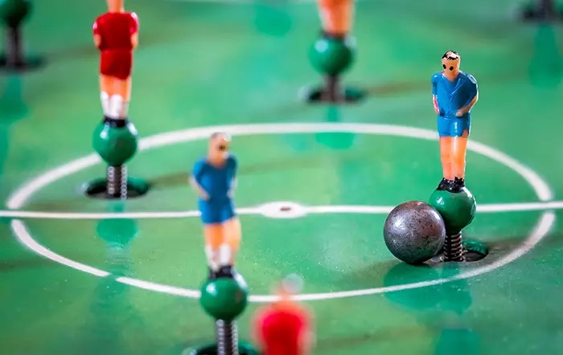

Slide 17
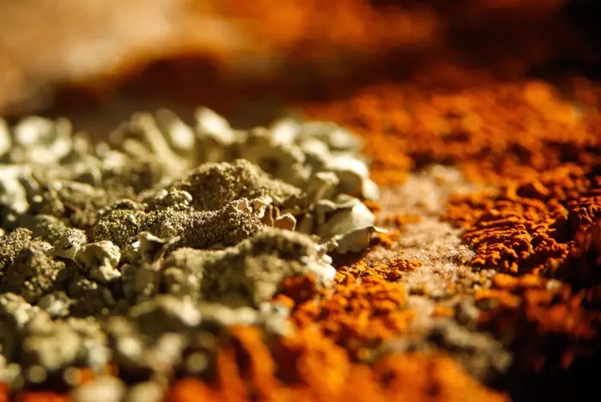

Slide 18
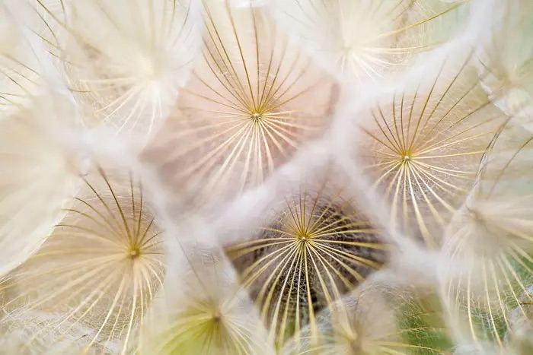

Slide 19
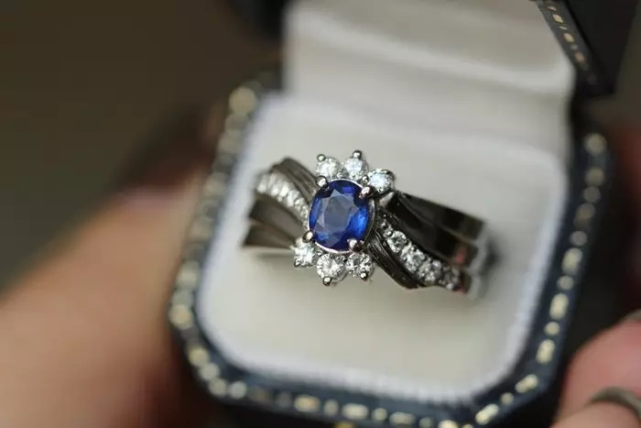

Slide 20
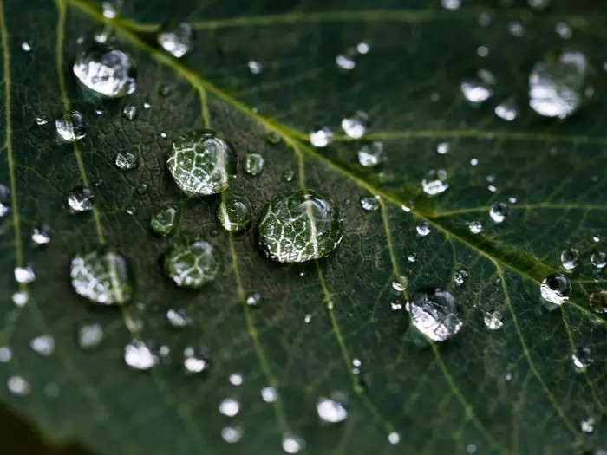

Slide 21
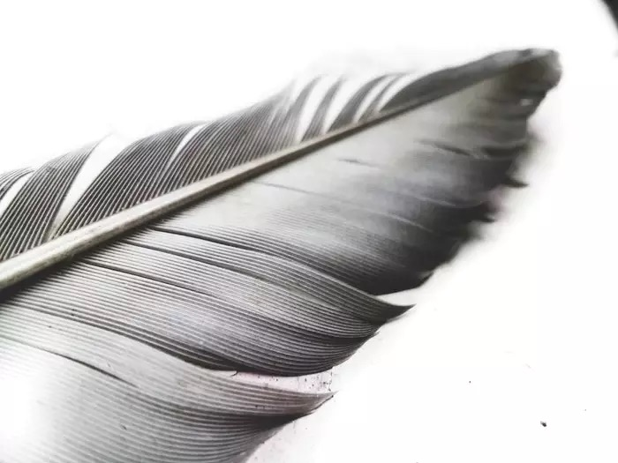

Slide 22
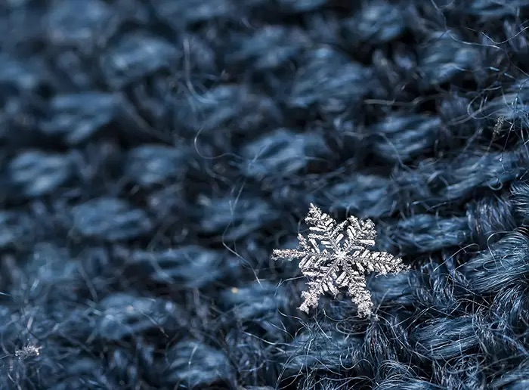

Slide 23
Stepping up level (or two!)

Slide 24
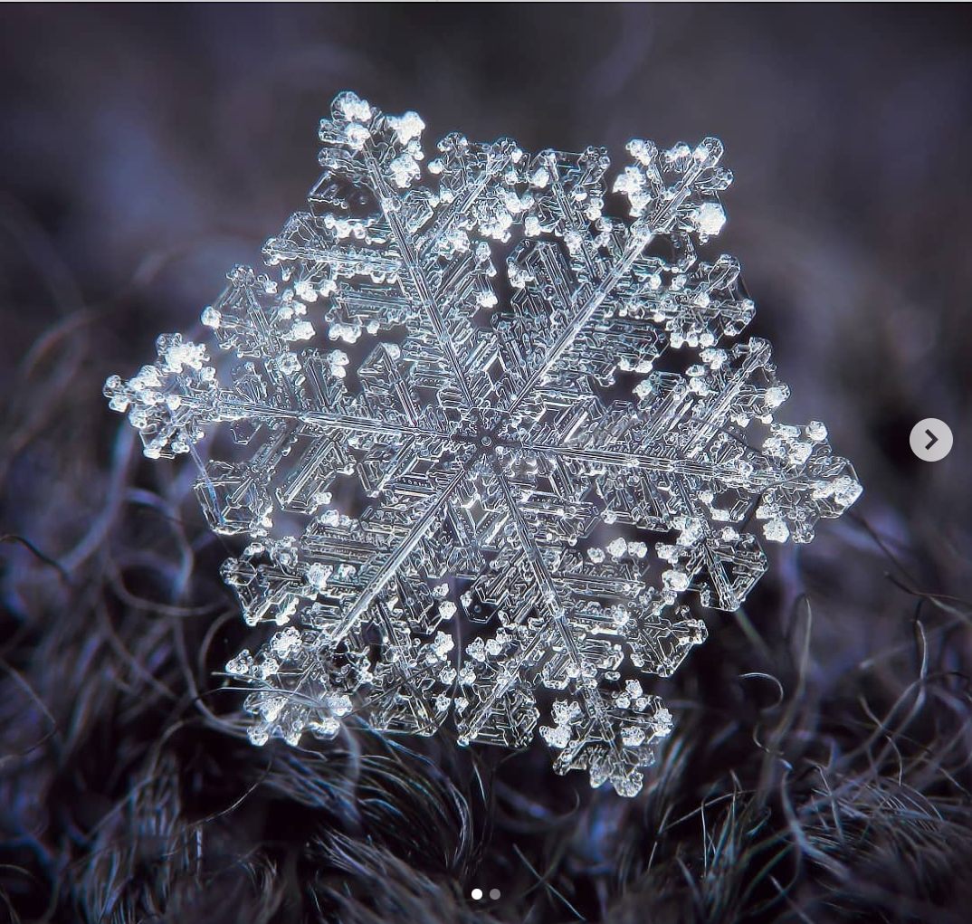

Slide 25
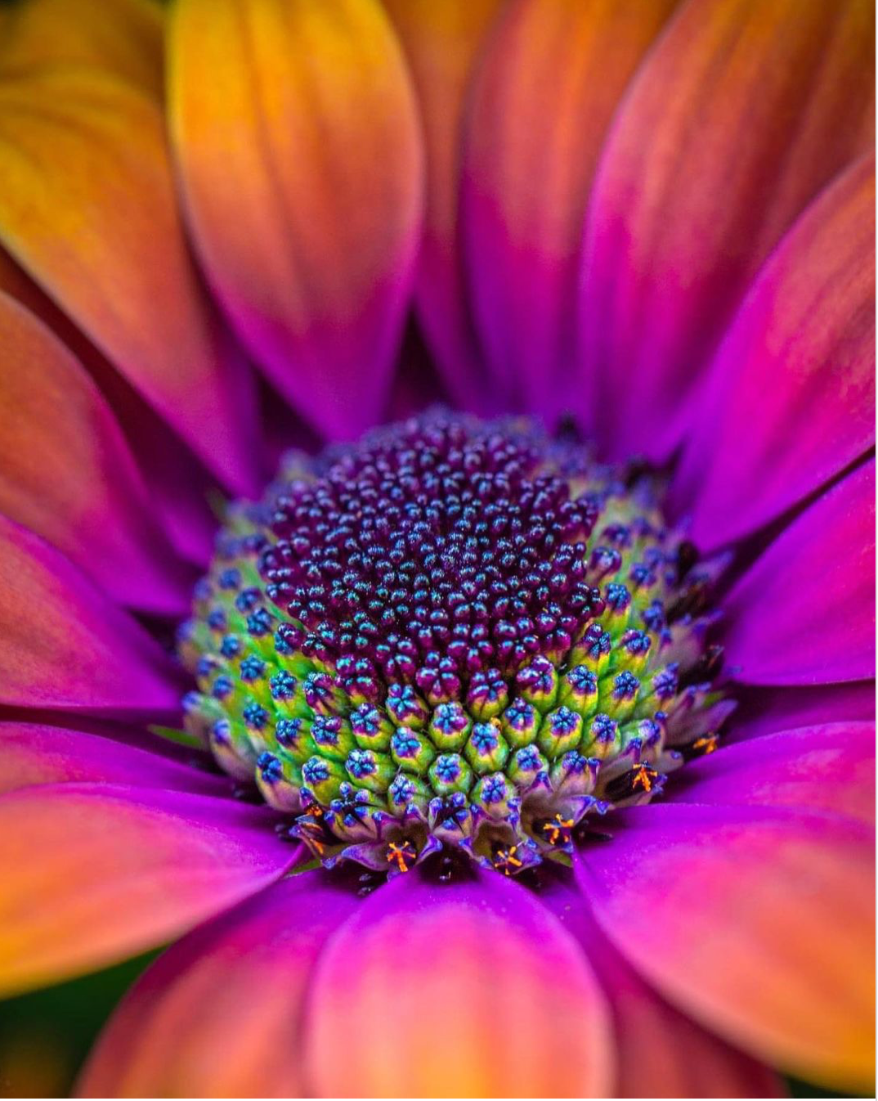

Slide 28
What were these last four images so good?

Slide 29
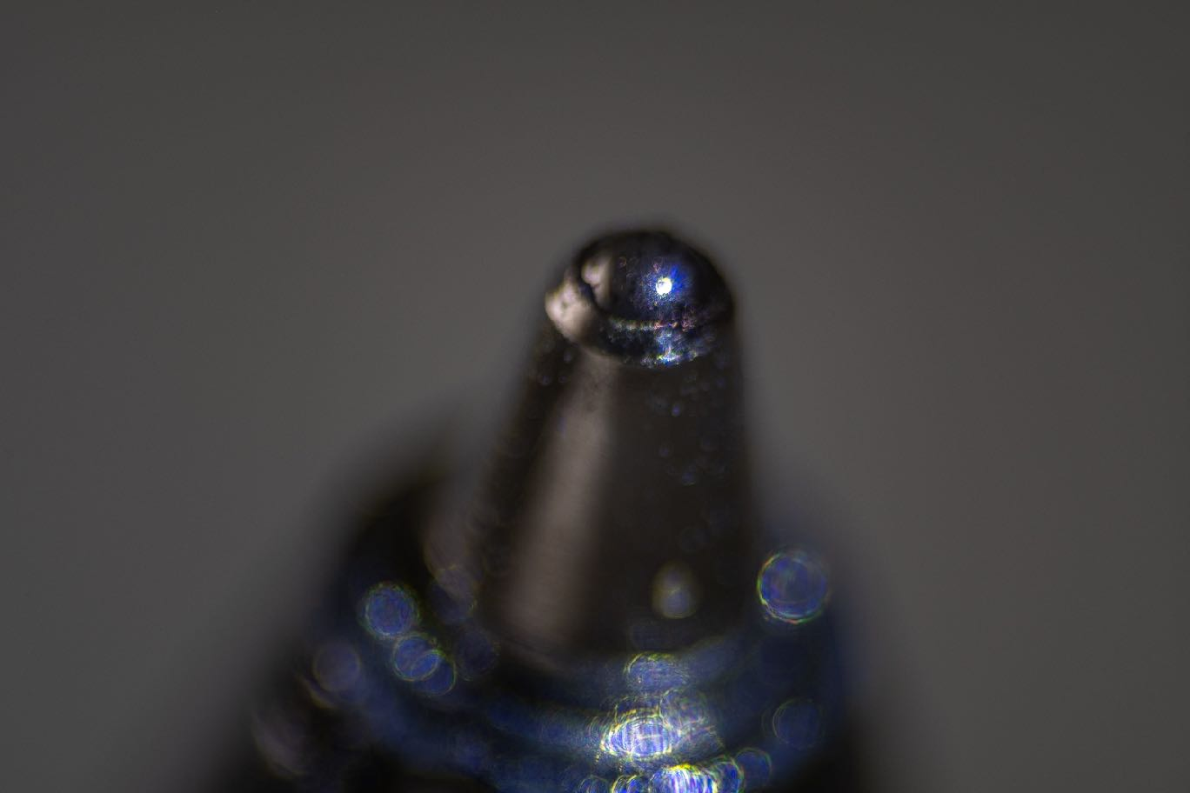
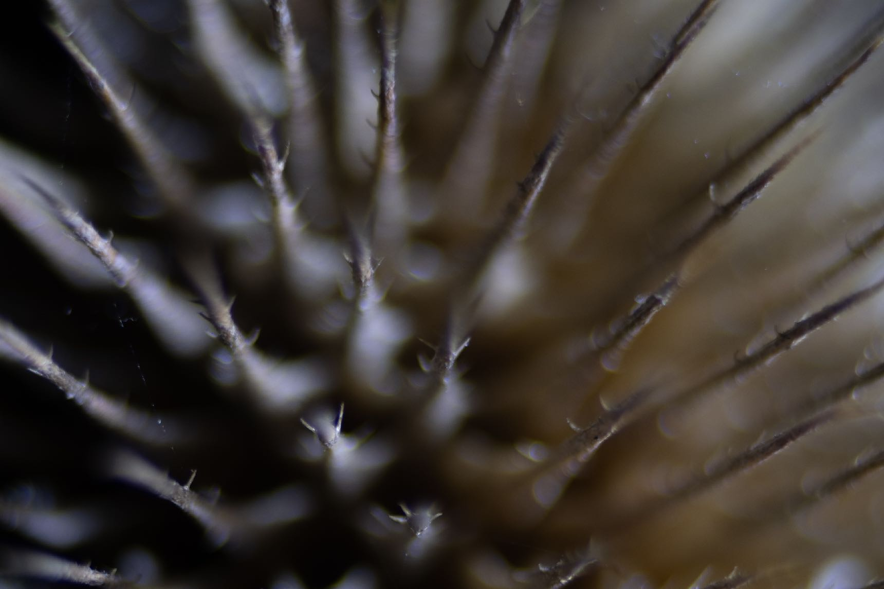
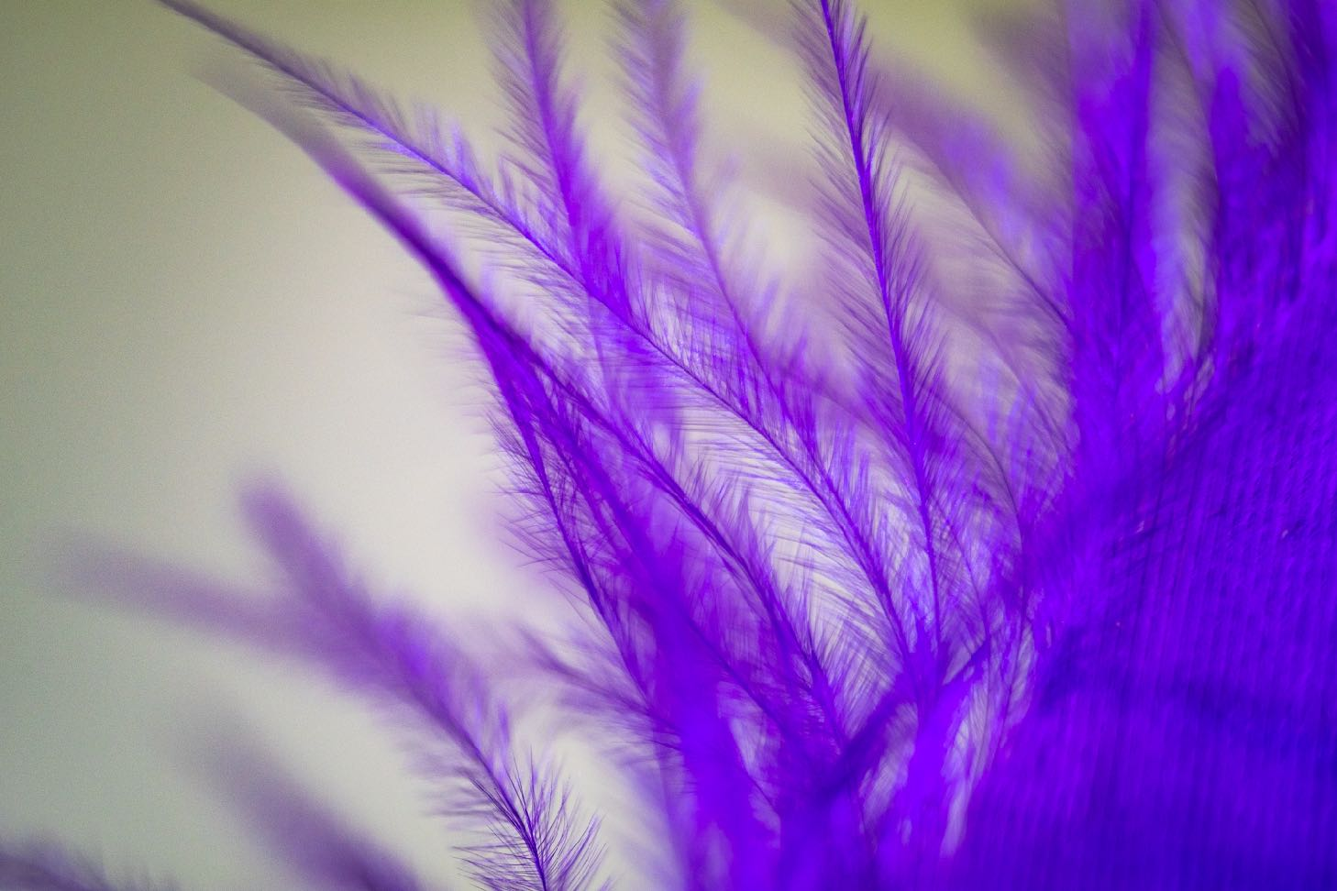
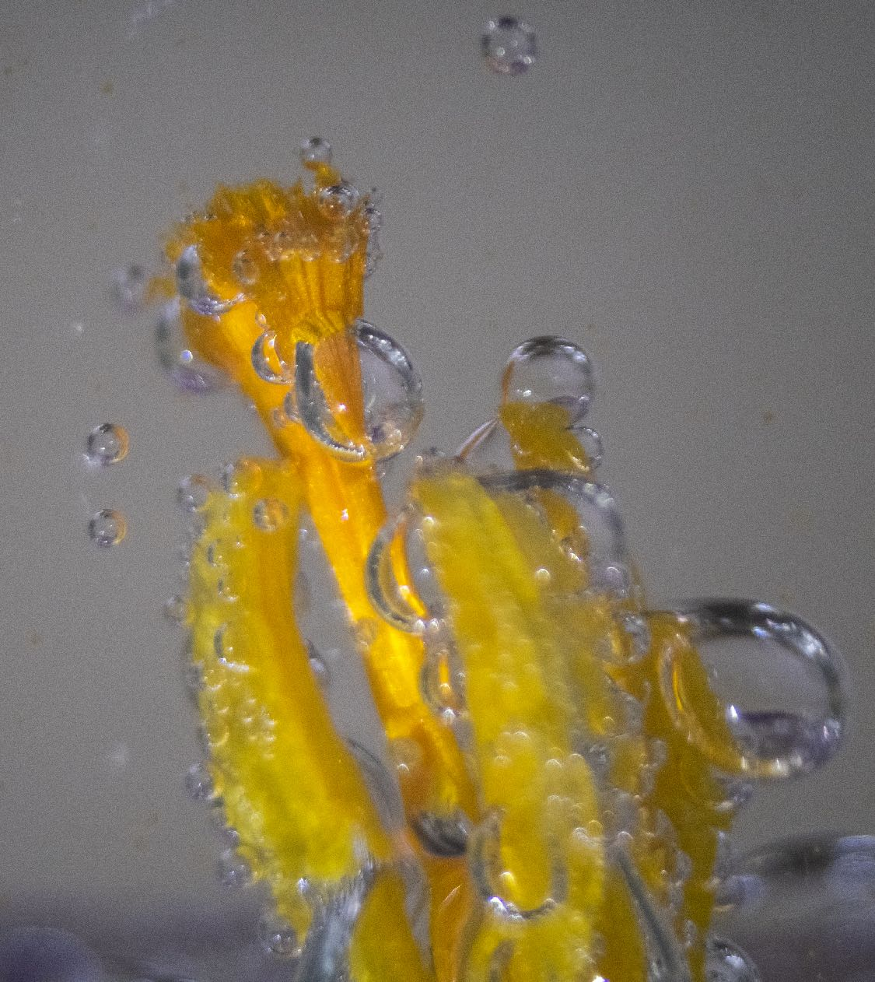
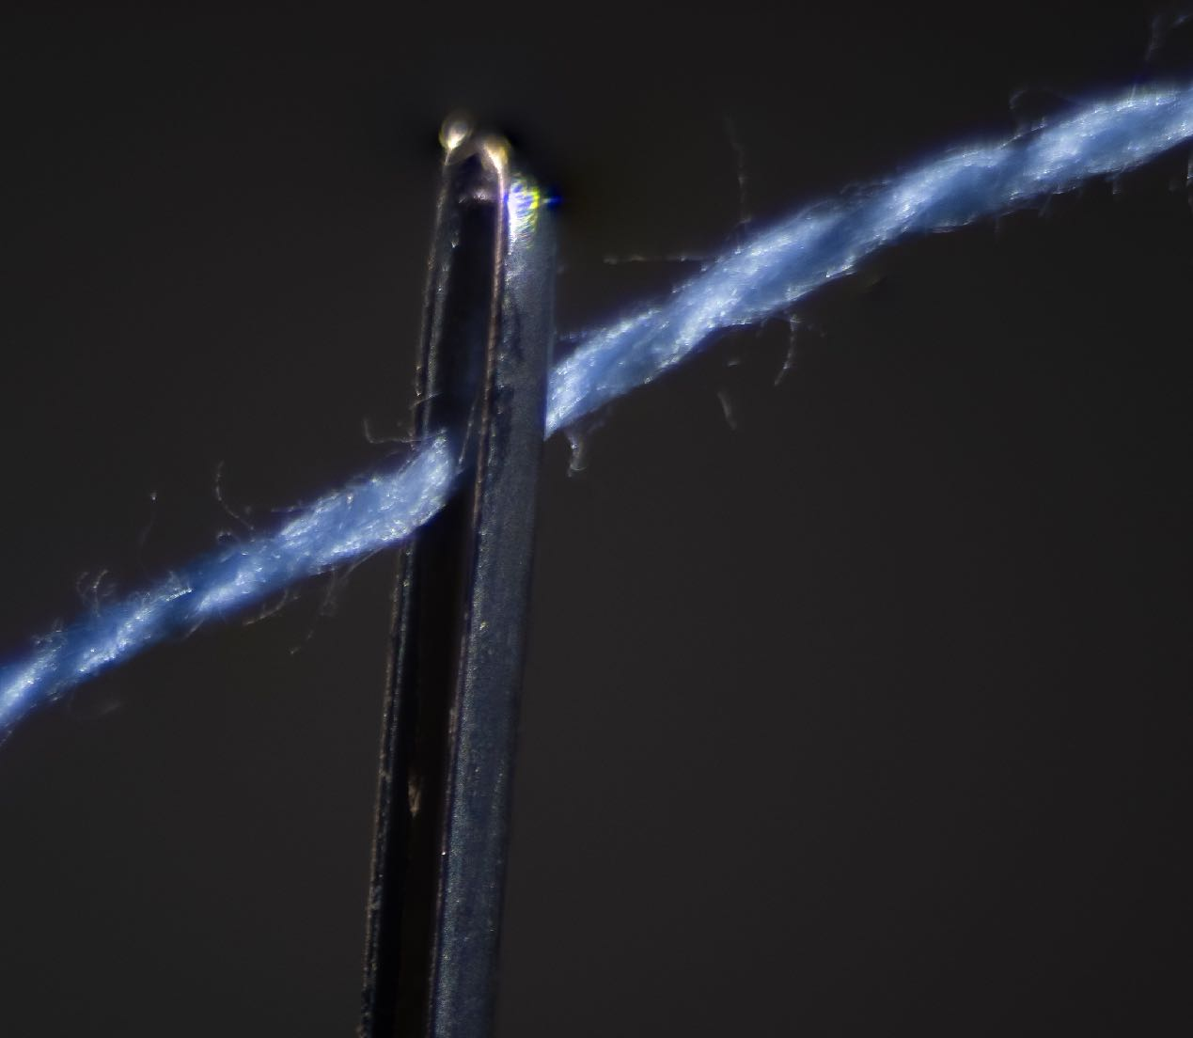
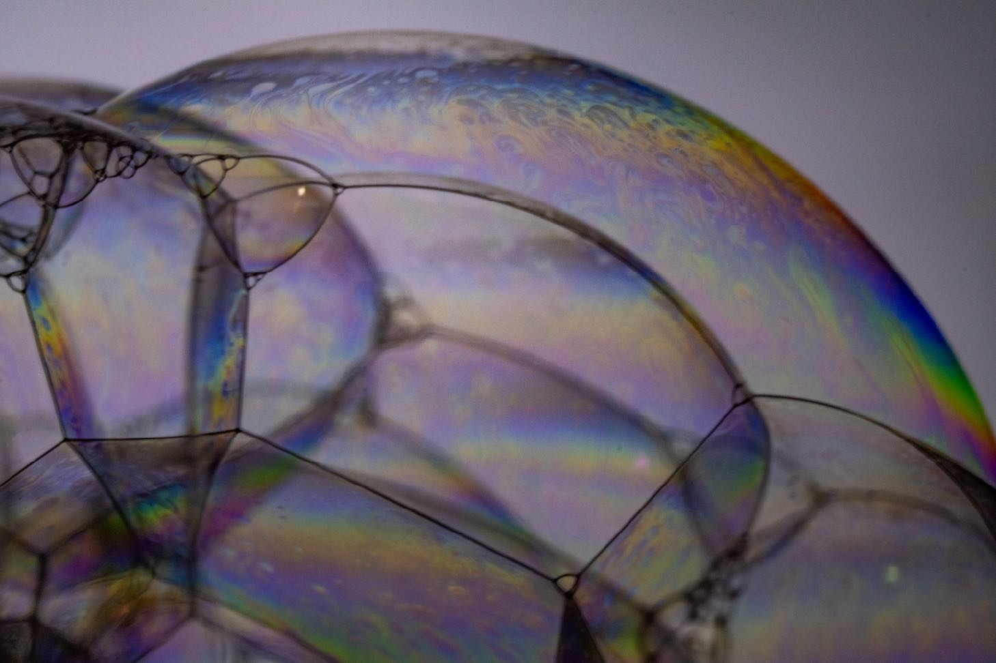
Hands on

Slide 30
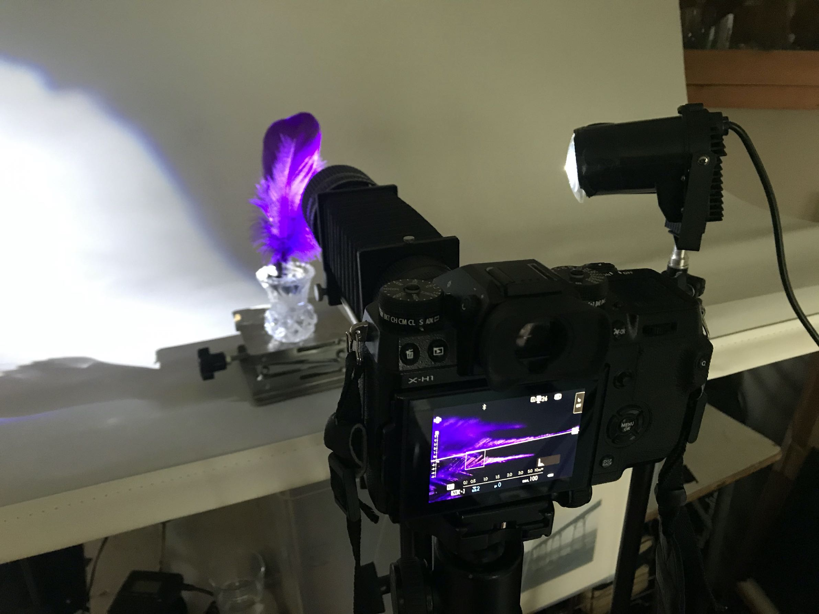
Demonstration
Using extension tubes and manual lens on an APSC 24Mp Mirrorless Fuji.

Slide 31
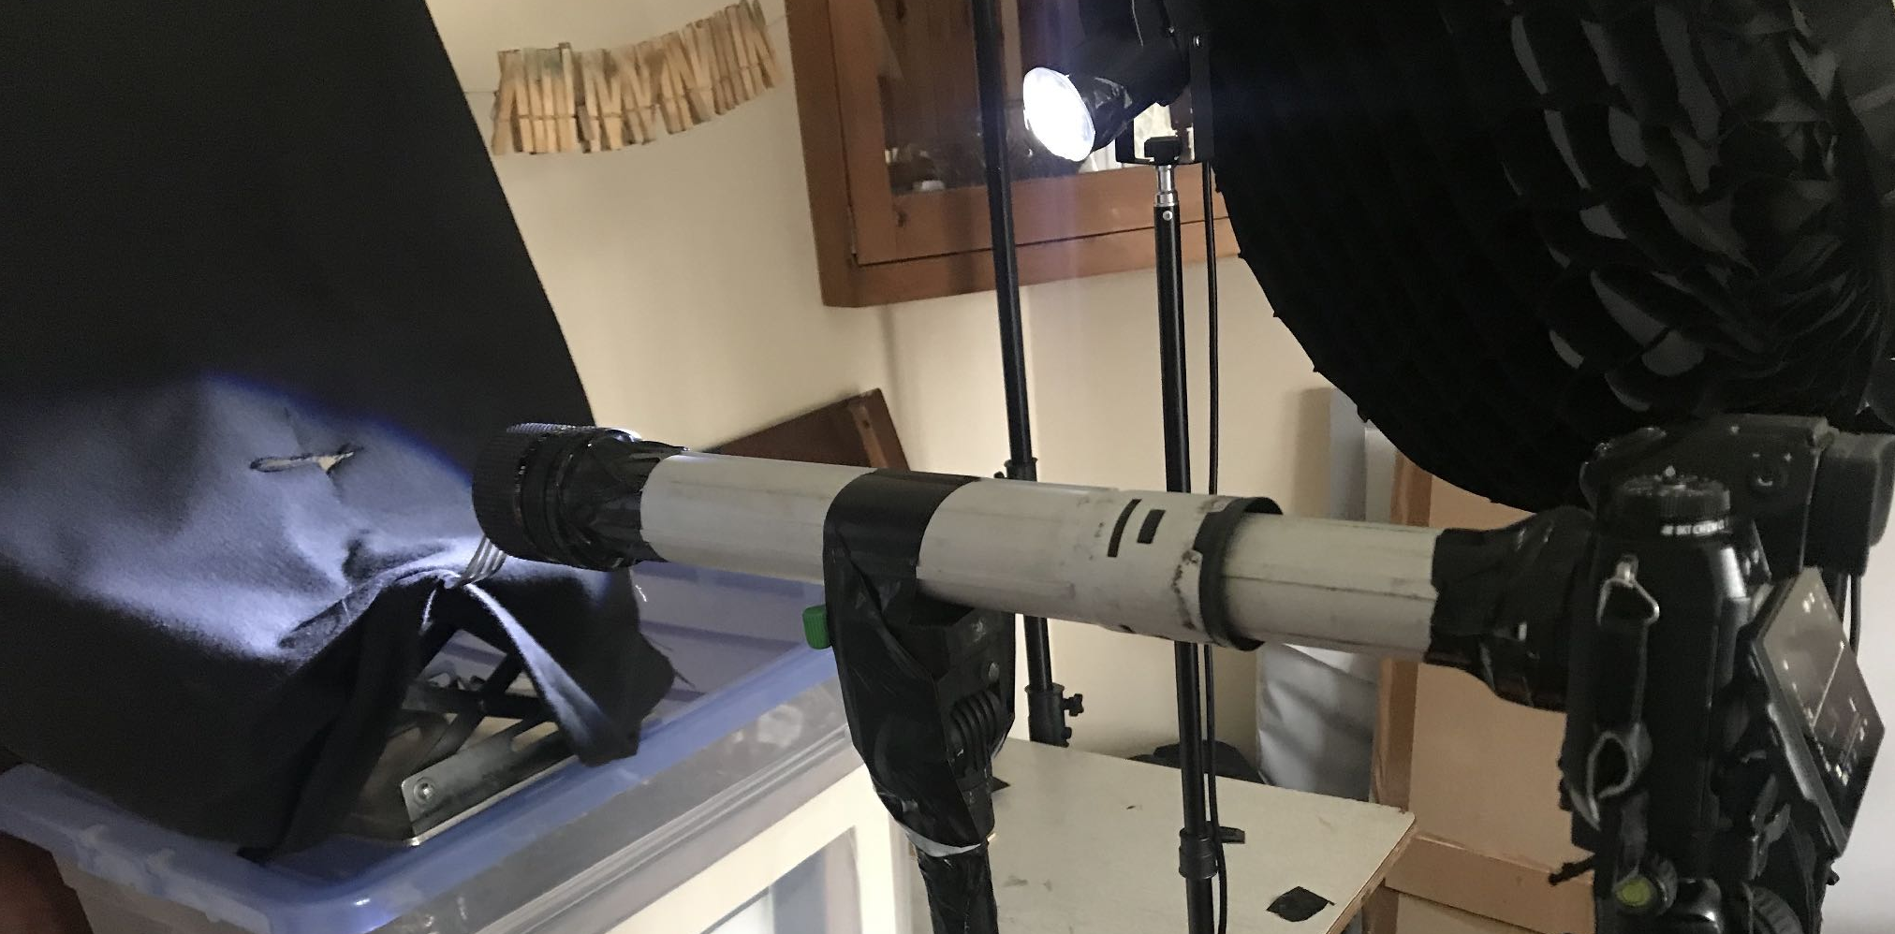
Even closer!
Using vacuum cleaner tube taped to lens and lens adapter APSC 24Mp Mirrorless Fuji.

Slide 32
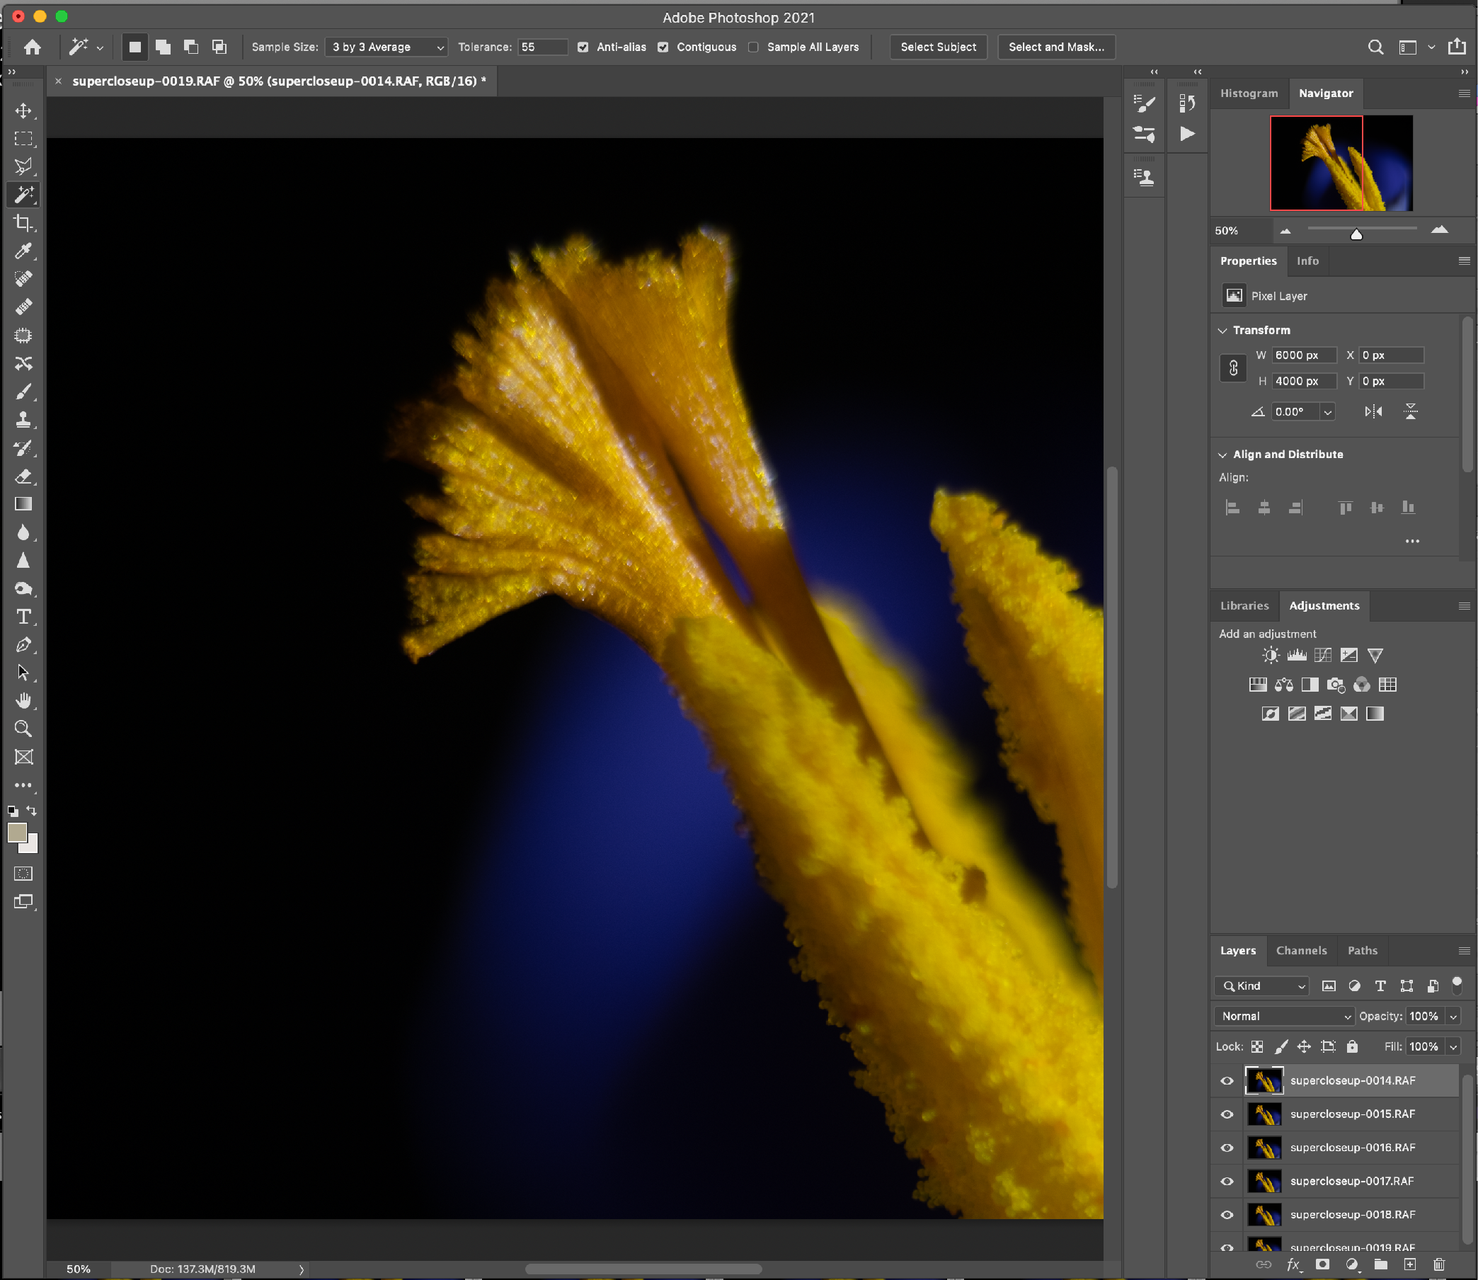
Post Processing
Focus stacking
1. Import images into Lightroom
2. Select the images to use and then right click and select “Edit in” “Open as layers in Photoshop”
In Photoshop now
1. Select all layers and click on the menu item “Edit” and “Autoalign Layers”
2. Keeping layers selected: click on the menu item “Edit” and “Autoblend Layers”
Wait ……
3. Click on the menu item “File” and “Save”. Your image is now available back in Lightroom so you can adjust colours cropping etc.

